Slide 1
FreeBSD Mail Server

Slide 2
Agenda
Why do this in today’s day and age?
Dangers and risks
Basics about running an email server
Setting things up together
Good practices for a mail server
Where to afterwards?

Slide 3
Why run your own?
Why not, if you can do it?
Privacy
Setting things up to your liking
Integration
Backup and disaster recovery
Name your own...

Slide 4
Dangers and risks
Mail not getting delivered (either direction)
Mail ending up in spam folders
The map is not the territory
Unknown exploits, 0-days, …
Data loss

Slide 5
Basics about email
SMTP
IMAP/POP
TLS/SSL, STARTTLS
Certificates
Relaying & Authentication
DNS – MX, SPF, DKIM, DMARC
Filtering for Viruses & Malware
Tarpitting
Blacklists

Slide 6
Core Requirements
FreeBSD 14.0 or higher
Static IP Address
Access to DNS management
Remote access via SSH or other secure means
Internet access, incl. ports 25, 80, 143, 443, 465, 993, etc.

Slide 7
SMTP Protocol
S: 220 smtp.example.com ESMTP Postfix
C: HELO relay.example.org
S: 250 Hello relay.example.org
C: MAIL FROM:<bob@example.org>
S: 250 Ok
C: RCPT TO:<alice@example.com>
S: 250 Ok
C: RCPT TO:<theboss@example.com>
S: 250 Ok
C: DATA
S: 354 End data with <CR><LF>.<CR><LF>
C: From: "Bob Example" <bob@example.org>
C: To: "Alice Example" <alice@example.com>
C: Cc: theboss@example.com
C: Date: Tue, 15 Jan 2008 16:02:43 -0500
C: Subject: Test message
C:
C: Hello Alice. This is a test message
C: Bob
C: .
S: 250 Ok: queued as 12345
C: QUIT
S: 221 Bye

Slide 8
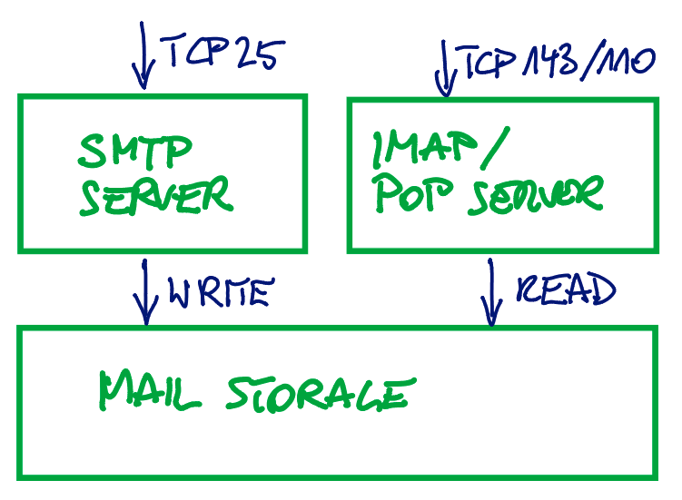
Elements of a Mail Server

Slide 9
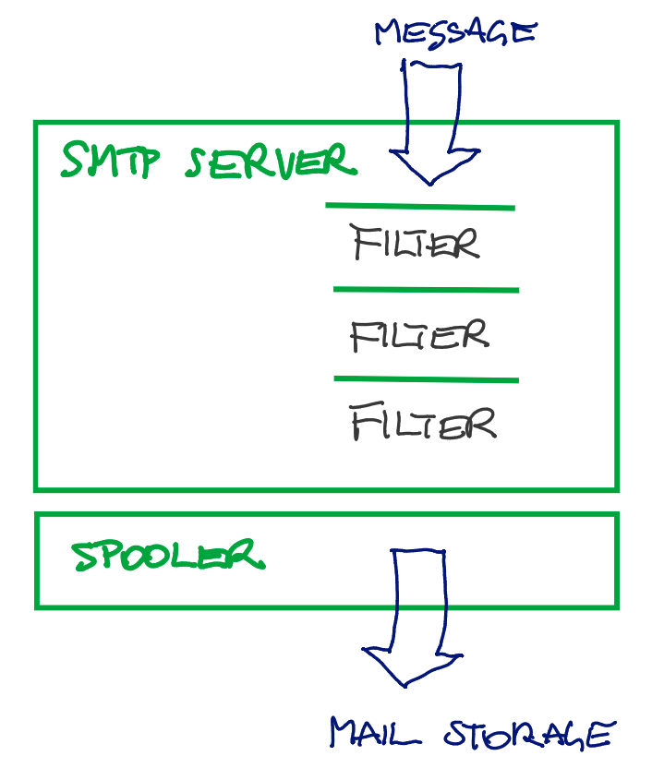

Slide 10
SMTP & IMAP/POP
SMTP 25, POP 110, IMAP 143
POP vs IMAP: Use IMAP for remote access
Plain Text-based
Inherently insecure
Security through wrapping in TLS
  STARTTLS – any port – starts with plaintext
  TLS/SSL – 465/587 and 993 – wraps from the start

Slide 11
Certificates
Private Key – keep secret, protect!
Public Key
Tooling
  Easy RSA – X.509, self signed CA
  Certbot & Let’s encrypt!
Issued to a specified domain/hostname

Slide 12
Relaying
Domain example.com
Hostname mail.example.com
Receiving for example.com
Sending for example.com
Open Relay: send for any other domain

Slide 13
Good Practice 1
To prevent operating as open relay, have mandatory authentication enabled
For sending to (SMTP, except for final delivery)
For receiving from (IMAP)

Slide 14
DNS - MX
The address book of the internet
MX record sets which mail server receives mail for which domain
Multiple mail server may be specified, they are ordered by a given priority number

Slide 15
DNS - MX
The address book of the internet
MX record sets which mail server receives mail for which domain
Multiple mail server may be specified, they are ordered by a given priority number

Slide 16
DNS
Reverse DNS of our mail server should point to the same hostname as forward DNS

Slide 17
DNS - DMARC
Domain based Message Authentication, Reporting and Conformance
Verification via SPF and DKIM
Allows specifying a recipient to receive reports of unverified senders (IP addresses)
Policy none, quarantine/report, or reject

Slide 18
DMARC example
Ignore (none)
Quarantine (quarantine)
Reject completely (reject)
v=DMARC1; p=quarantine; rua=mailto:postmaster@example.org

Slide 19
DNS - SPF
Sender Policy Framework
Defines which servers, IPs may send email
Only one SPF record per domain allowed!
Simple TXT record

Slide 20
DNS - DKIM
Public key stored in DNS
Private key remains on server and is used to sign outgoing messages
Receiving end verifies signature of message to assess authenticity of the sender
Additional indicator for spam

Slide 21
Optional DNS
MTA-STS
  DNS Record points to policy on web server
  Policy specifies use of TLS
DANE
  DNS based authentication of named entities
  TLSA DNS record publishes protocol and certificate data

Slide 22
Good Practice 2
Have reverse DNS properly configured

Slide 23
Good Practice 3
Have SPF, DKIM and DMARC enabled

Slide 24
Additional anti-spam measures
Tarpitting
  Slows down sender
  Intentionally fails to make sender re-send later
Blacklists
  Registries of known IP addresses that send spam
  Unlisting may be requested, but may require time and proof that spamming stopped

Slide 25
Mail Filter
Spam Assassin filters against spam
  Verifies DKIM and SPF
  Checks against blacklists
  Runs statistics against known message patterns
Amavis runs virus scanner
  Clamav open source scanner

Slide 26
Good Practice 4
Keep your system and installed software up-to-date and use additional security measures (i.e. firewall, et al)

Slide 27
Good Practice 5
Don’t force TLS/SSL – there are still many mail servers that will simply fail otherwise
Use MTA-STS, DANE instead

Slide 28
More things to consider
Backing up mails
Restore mails
TOTP 2FA for SSH
Setting mailbox quotas
Collect and block misbehaving IPs in firewall
Enable audit framework

Slide 29
Roadmap – Server
Install packages
  cyrus-imapd38 cyrus-sasl cyrus-sasl-saslauthd
  redis
  postfix-sasl
  amavisd-new clamav clamav-unofficial-sigs spamassassin spamassassin-dqs spamass-milter opendkim spamd amavisd-milter

Slide 30
Roadmap – Hardening SSH
Limiting users allowed to use SSH
Limiting allowed ciphers
Optional: 2FA via TOTP code

Slide 31
Roadmap – Base Config
Setting sysctl
Set up basic pf firewall
Disable sendmail
Install doas
Install and set up sshguard, fail2ban, ssmtp

Slide 32
Roadmap – Get Certificates
Set up certbot
Request/acquire a certificate and private key
Install and secure certificate
For lab purposes: use easy-rsa

Slide 33
Roadmap – Initial DNS setup
Check reverse DNS
Enter MX record
Enter SPF record

Slide 34
Account Handling
System Logins
Email Logins
Virtual Accounts – System ≠= Email

Slide 35
Roadmap – Postfix SMTP
Apply certificate
Add virtual users
Configure TLS
Configure LMTP transport to mailboxes
Enable SASL Auth

Slide 36
Roadmap – Cyrus IMAP
Apply certificates
Enable TLS
Create and authorize mailbox

Slide 37
Roadmap – Spamassassin
Install and compile rules
Disable auto learning
Configure spam reporting
Enable via milter

Slide 38
Roadmap – Amavis
Set up virus scanner
Set up signature updates
Disable spam checks
Apply via milter

Slide 39
Roadmap – Postfix Hardening
Require authentication
Reject various attacks

Slide 40
Roadmap – Set up pf firewall
Allow required ports
Block anything else

Slide 41
Roadmap – OpenDKIM
Set up keys
Add key to DNS
Enable signing via milter

Slide 42
Testing Email Server
smtptest
troubleshooting SASL in /usr/local/lib/sasl2/smtpd.conf
  log_level: 9
  pwcheck_method: auxprop
  auxprop_plugin: sasldb
  mech_list: PLAIN LOGIN CRAM-MD5
  DIGEST-MD5 NTLM

Slide 43
Testing Email Server
Verifying Spamassassin works
Verifying Amavis / Virus Scanning works

Slide 44
Training Spamassassin
Ham vs Spam
Both required to learn correctly
Adding your own rules
Modifying scores for existing rules
Writing your own rules
/usr/local/etc/mail/spamassassin/local.cf

Slide 45
Sieve Mail Filter
require "fileinto";
if header :contains ["subject"] "[SPAM]" {
fileinto "INBOX/Junk";
}

Slide 46
Installing a sieve filter
sieveshell localhost
put default.src
activate default.src

Slide 47
Managing mails
/usr/local/cyrus/sbin
Not in $PATH
quota
unexpunge
cyr_expire
mbpath

Slide 48
Roadmap – Set up webmail
Install nginx, php, postgresql
Install certificates, enable TLS/SSL
  https://docs.nextcloud.com/server/latest/admin_manual/installation/nginx.html
Download nextcloud
  https://download.nextcloud.com/server/releases/
Create database user
Run nextcloud installation
Install nextcloud mail app
Enable two-factor authentication

Slide 49
Nextcloud Caveats
DKIM signature broken when sending
Deleting emails with Thunderbird breaks email listing in nextcloud – data inconsistency
pkg installation vs zip package
  pkg audit will not catch vulnerabilities
  update/upgrade in your own pace, with all risks and benefits

Slide 50
Alternative Webmail Apps
Horde (no file sharing)
Sogo (no file sharing)
Squirrelmail (mail only, no calendar)

